Slide 1

Reproducible code
Open Science tu/e
Dr.ir. Tim Kuijpers, Biointerface Science group, mDR, Biomedical Engineering

Slide 2
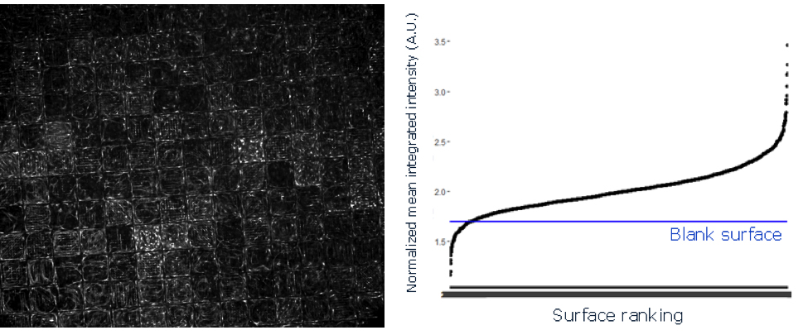
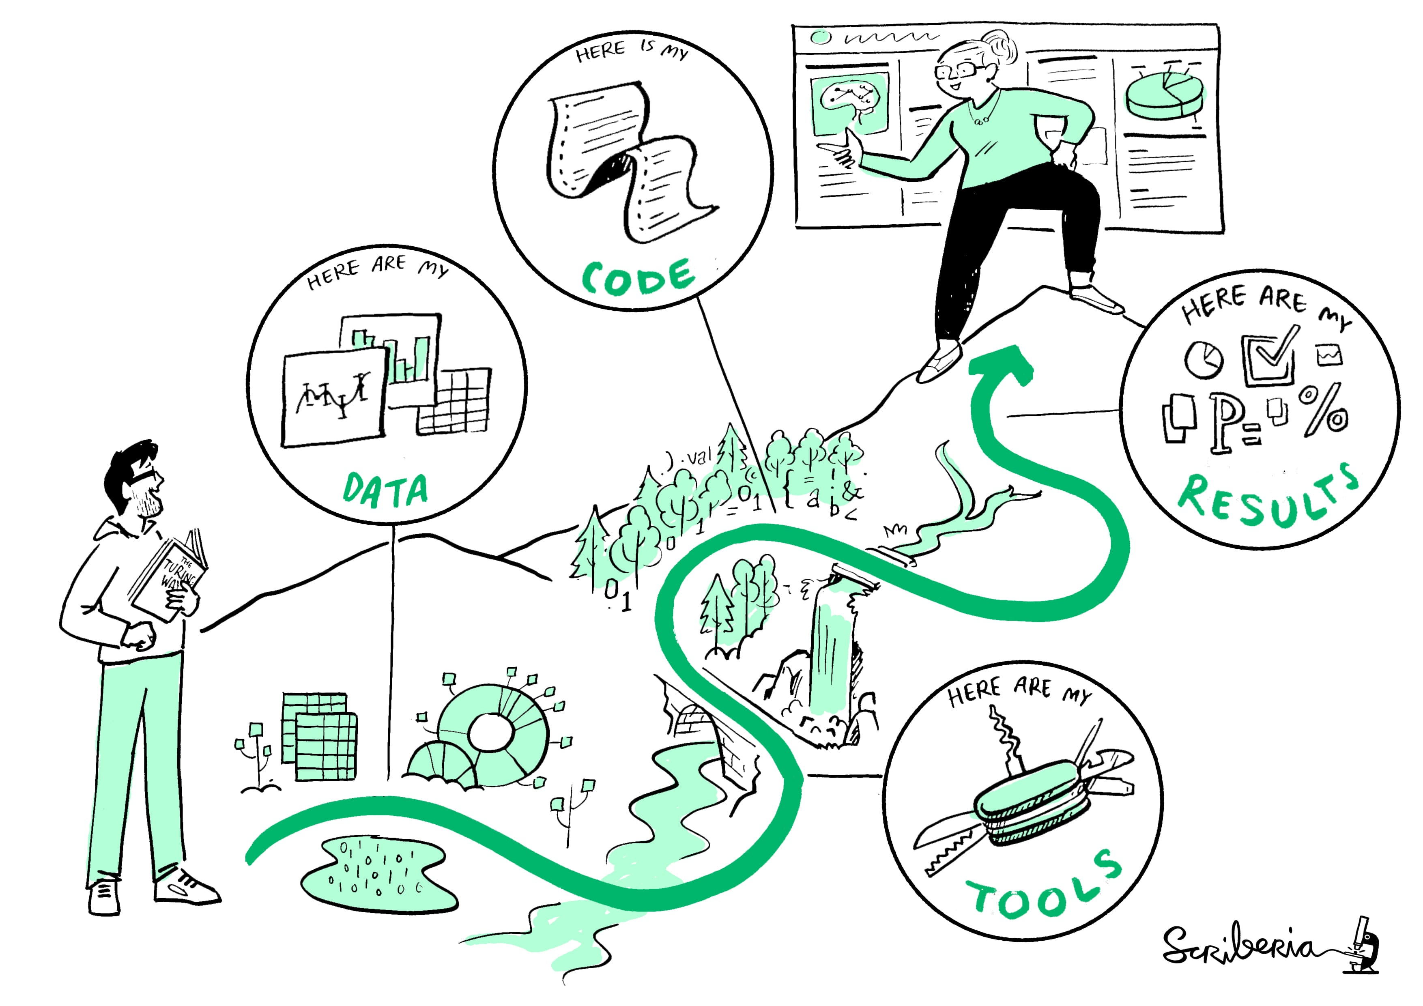
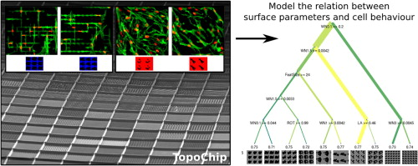


Introduction

Slide 3
Introduction
Outline of the presentation
Documentation
What do you need to execute this project?
Where do you start?
Organization
Can we define a workflow?
Automation
Can we prevent human error?
Dissemination
Share your code

Slide 4
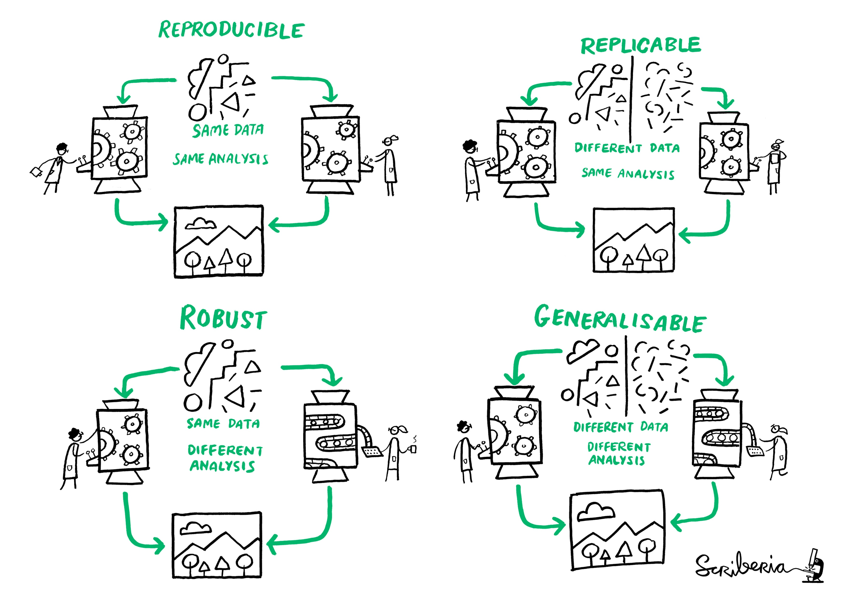
Introduction
Reproducible
Authors provide all the necessary data and the script to run the analysis again
The turing way
https://the-turing-way.netlify.app/welcome

Slide 5
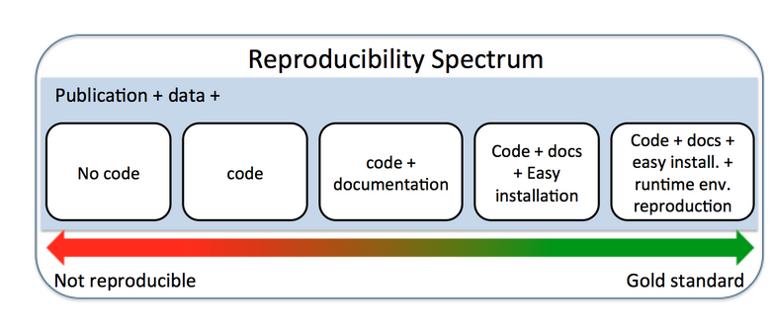
Introduction

Slide 6
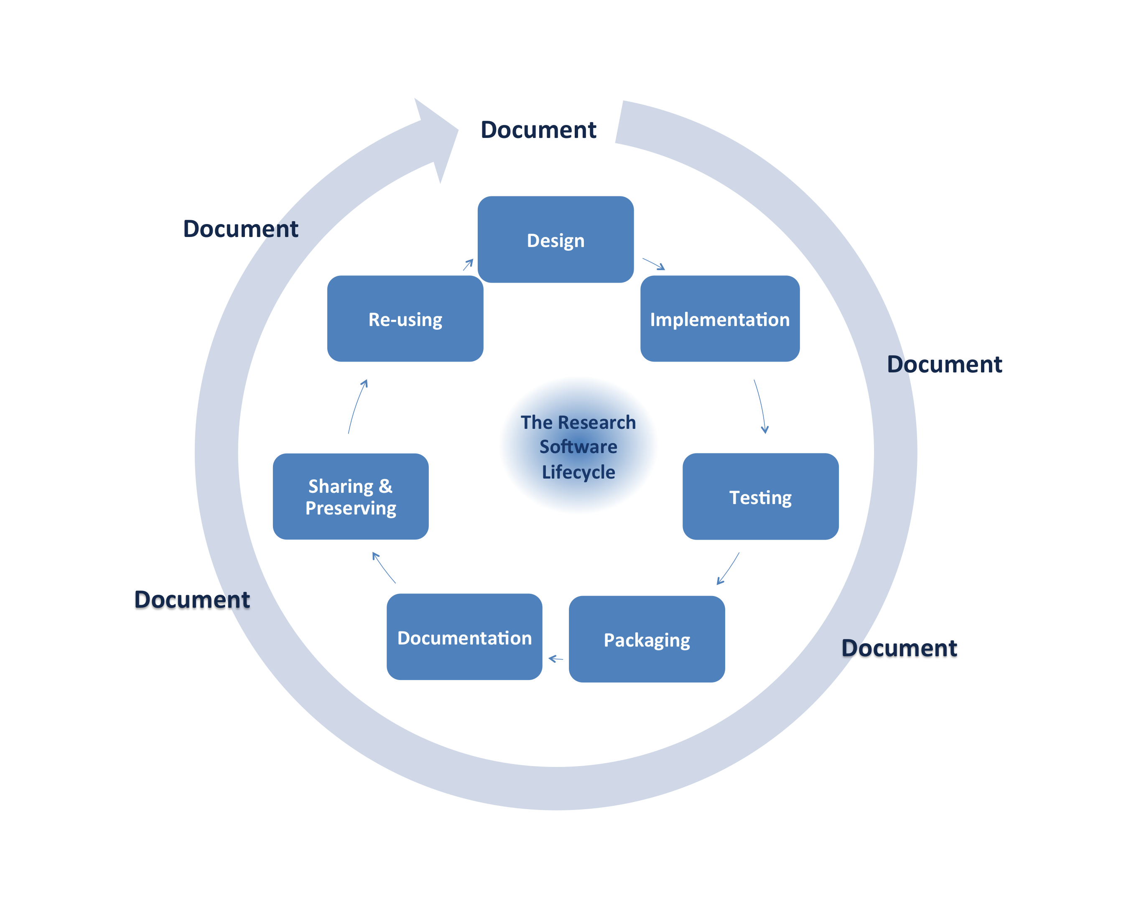
Introduction: software life cycle
Berkeley: reproducible research practices: Software best practices
https://guides.lib.berkeley.edu/c.php?g=652220&p=4575512

Slide 7
Code reproducibility: writing code

Slide 8
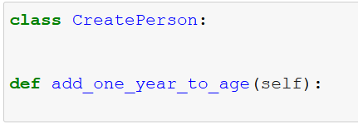
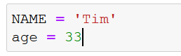
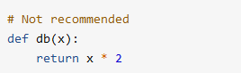
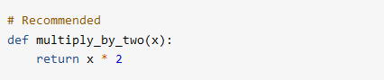
Code reproducibility: writing code
Apply a styling convention
PEP-8 in Python
PEP-7 for C
Google’s style guide for R
Function names

Slide 9
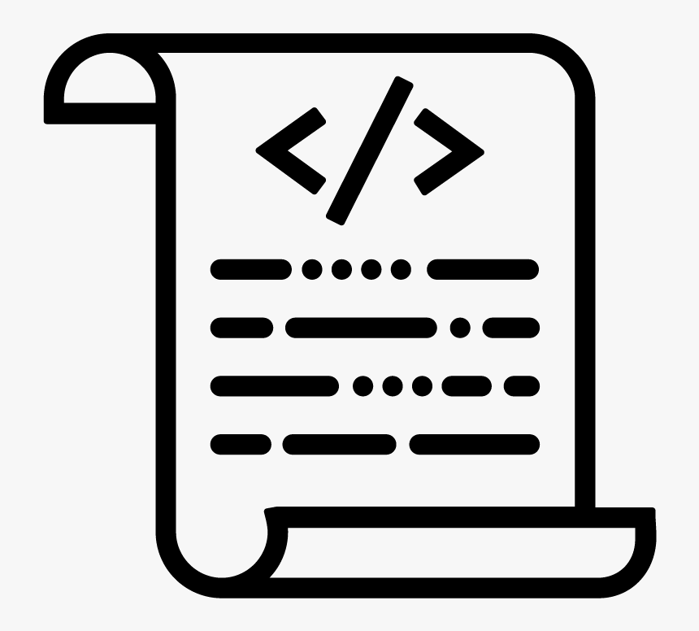
Code reproducibility
Writing code
Do one thing well:
Read data script _projectA
Project A
Project B
Read data script _projectB
Read data script
Project C

Slide 10

Code reproducibility
Writing code
Do one thing well:
Read data
Plot Data
Write data
Write one file per function
Avoid scripts with 10 functions and 1000 lines

Slide 11
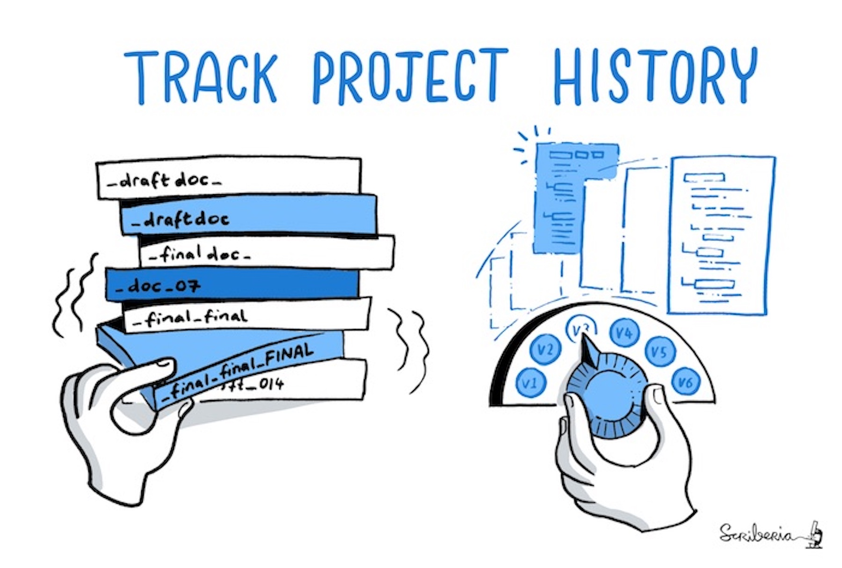
Code reproducibility
Version control system: git
GUI-client: Github or Atlassian

Slide 12
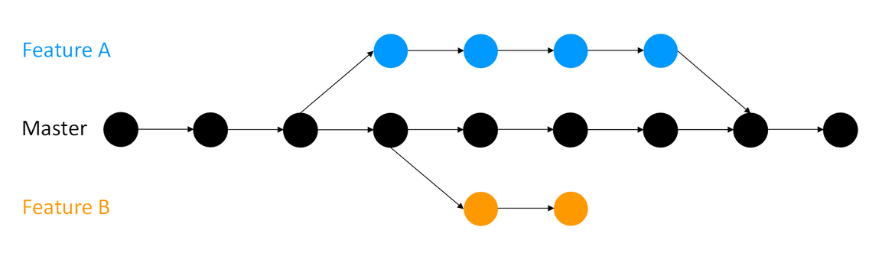
Code reproducibility: version control

Slide 13
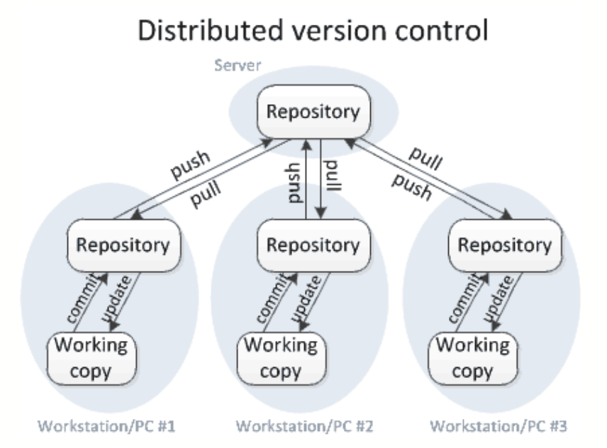
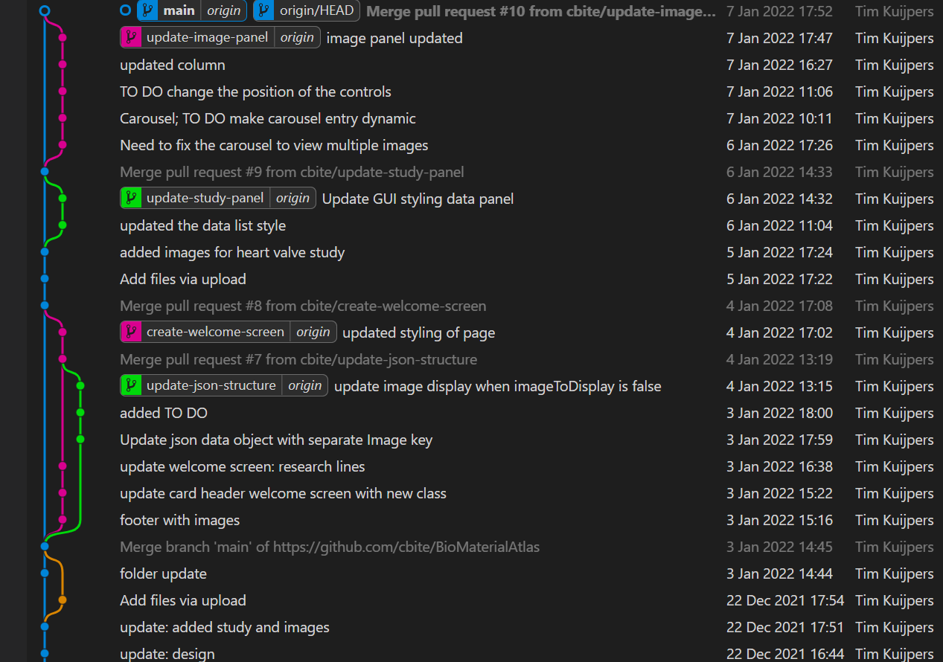
Code reproducibility
Version control system: git
GUI-client: Github or Atlassian

Slide 14
Software life cycle
Berkeley: reproducible research practices: Software best practices

Slide 15
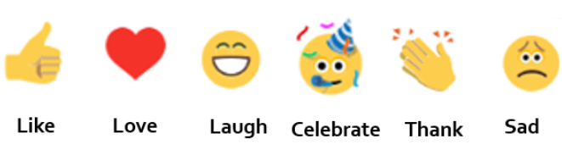
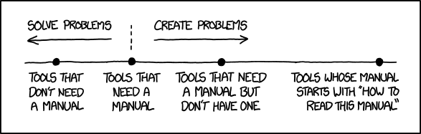
Code reproducibility: documentation
Question 1: did you have problems running a script because of no documentation?
Yes
No

Slide 16
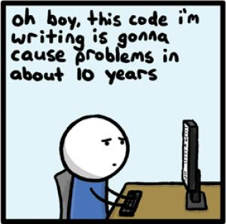
Code reproducibility: documentation
Question 2: do you always document your code?
Yes
No

Slide 17
Code reproducibility
Code documentation
Three types of documentation
Code comments
Readme files
Manual

Slide 18
Code reproducibility
Code comments
Comments are annotations you write in your scripts
Written for users who deal with the source code
Explain parts that are not intuitive from the code itself
Code comments
$scope.selectData=function(){
// select name[1] to enter the data object in the nested json
var selected_name=this.name[1].Description.Name
// select the data based on the button click
var tmp_data_all=Object.values($scope.data);
// filter through the data to find the name
tmp_data_all.forEach(element =>{
// see if the element study description name is equal to the name of the button
if(element.Description.Name==selected_name){
$scope.datasetSelected=element;
}

Slide 19
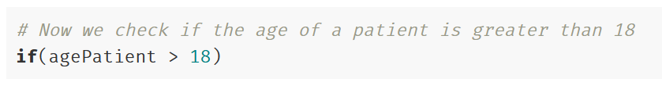
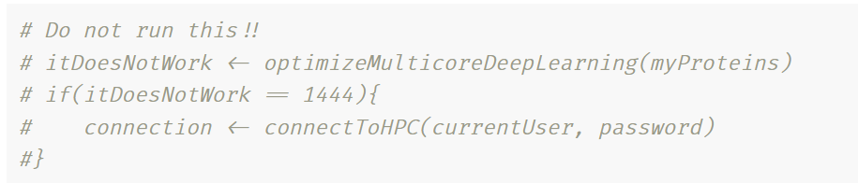
Code reproducibility
But you do not need to use comments to repeat in common words what is written in your code
Do not use comments to inactive code in a published script
Code comments

Slide 20
Software life cycle
Berkeley: reproducible research practices: Software best practices

Slide 21
Code reproducibility: create a package
Question 3: did you ever run into problems because files were missing?
Yes
No

Slide 22


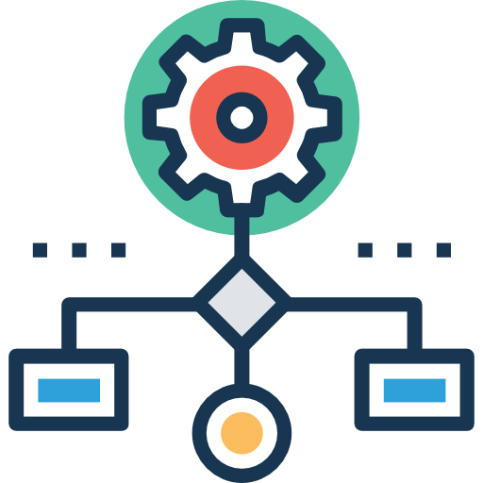

Code reproducibility: create a package
Example from BioInterface Science group

Slide 23
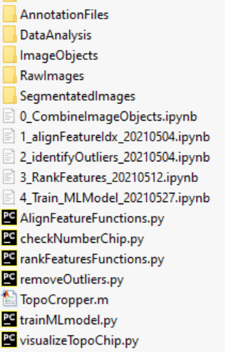
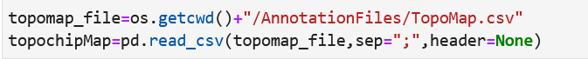
Code reproducibility: create a package
Provide a software package
Data dependencies scripts
Necessary scripts

Slide 24
Code reproducibility: create a package
Organize your directories
Input folder
Output folder
Annotation folder
Setup folder
Folder can be zipped and shared by researchers as a template folder for their analysis

Slide 25
Code reproducibility
Identify assumptions in your code
What assumptions exists on your data
What assumptions exist on the input of a function
Make the assumptions explicit
Option 1: write a readme file and state the assumptions
Option 2: write a script that checks the validity of the data

Slide 26
Code reproducibility
Code documentation
Three types of documentation
Code comments
Readme files
Manual

Slide 27
Code reproducibility
Readme file
‘Small’ but essential file which should contain at least:
Readme files
📝 Provide a short description of the tool.
✔️ Provide a list of prerequisites to run the application.
📥 Provide instructions on how to install the program locally.
📖 Provide a few working examples that illustrate how to run the program main features.
https://maastrichtu-ids.github.io/best-practices/

Slide 28
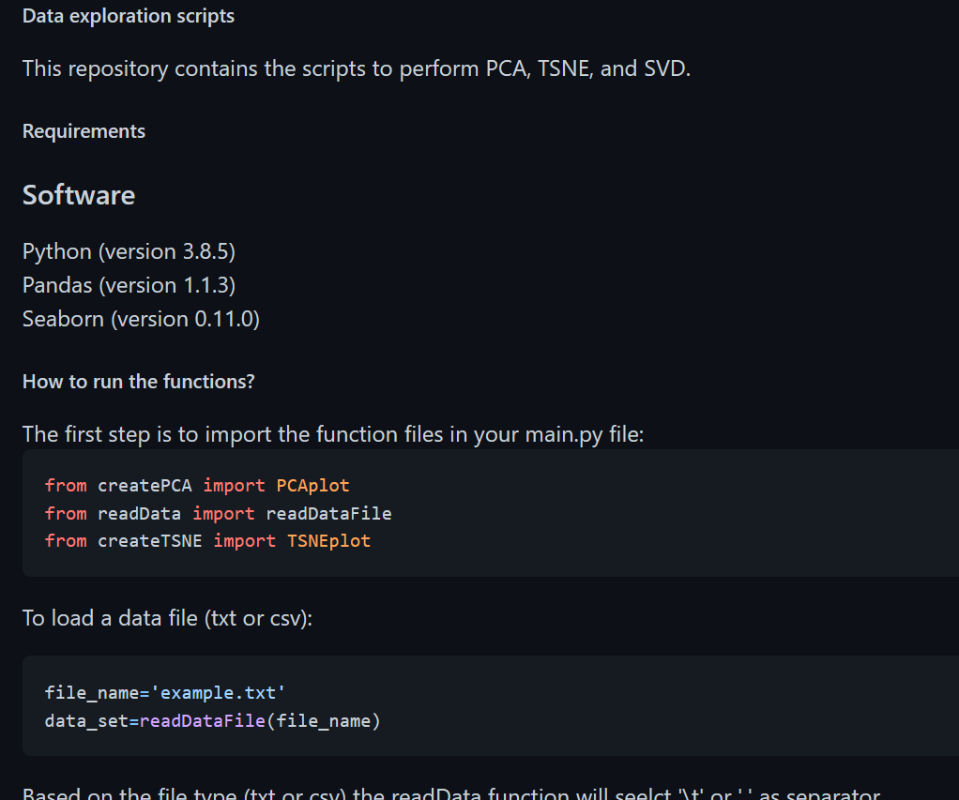
Code reproducibility
Readme files

Slide 29
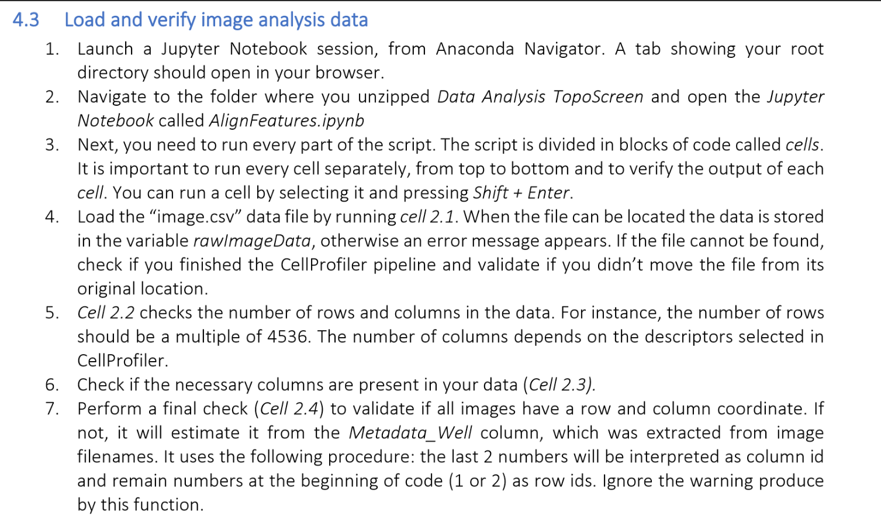
Code reproducibility
User manual
Wrote Standard Operation Procedures (SOPs)
Manual

Slide 30
Code reproducibility
How to start writing a Manual?
Manual
1
Team member 1: write the draft
2
Team member 2: review the draft
3
Team member 1: revise draft
4
Team member 3: review the draft
5
Team member 1: revise the draft
Manual

Slide 31
Code reproducibility: dependency package
Question 4: Will a software package with the scripts and folder structure solve everything?
Yes
No

Slide 32
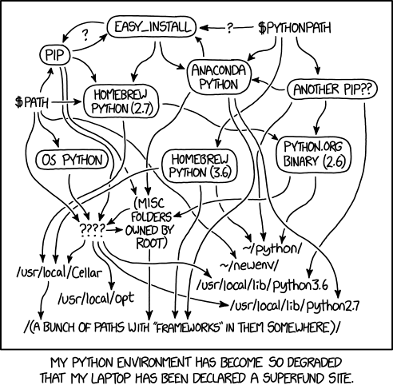
Code reproducibility: dependency package

Slide 33

Code reproducibility: dependency package
The curse of dependencies
Reproducibility: we can control our code but how do we control dependencies?
Dependency ‘hell’: different codes on the same environment can have conflicting dependencies
Solution: Conda, Anaconda, pip, virtualenv, Pipenv
Environment.yml file

Slide 34






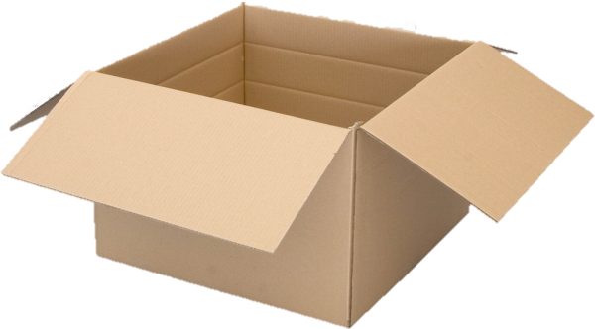
Code reproducibility: dependency package

Slide 35
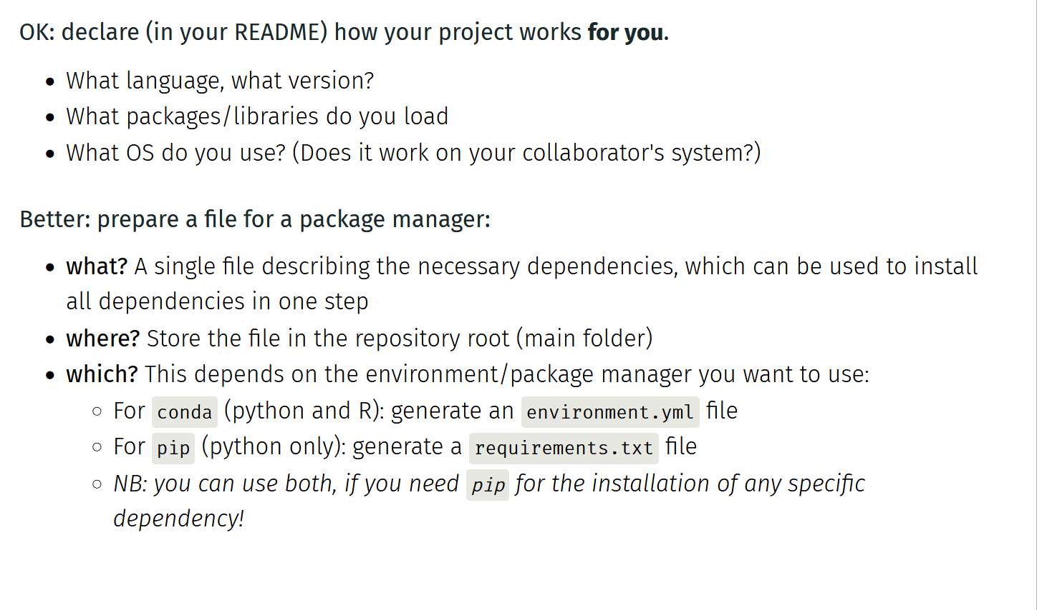
Code reproducibility: dependency package

Slide 36
Introduction

Slide 37


Code reproducibility: dependency package

Slide 38
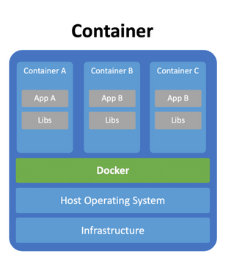
Code reproducibility: dependency package

Slide 39

Code reproducibility and research
How to share your analysis?

Slide 40
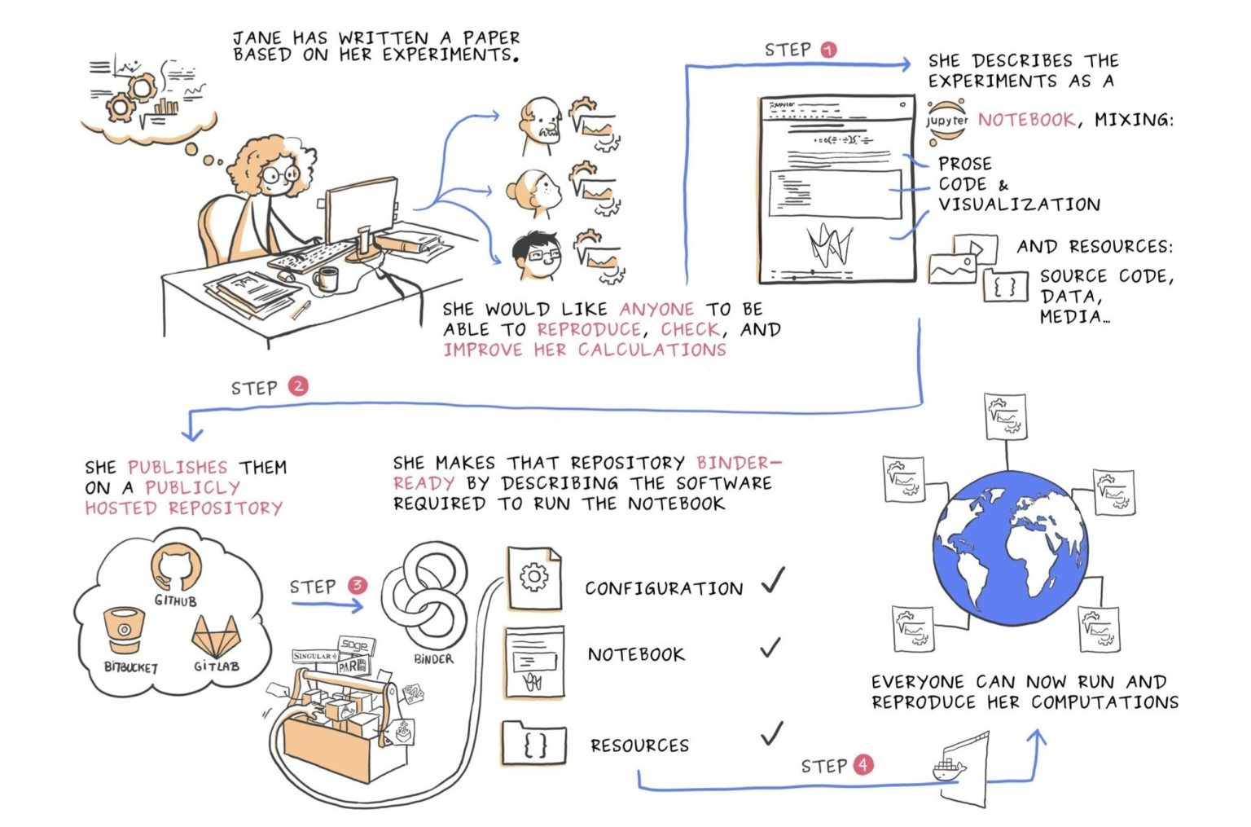
Code reproducibility and research

Slide 41
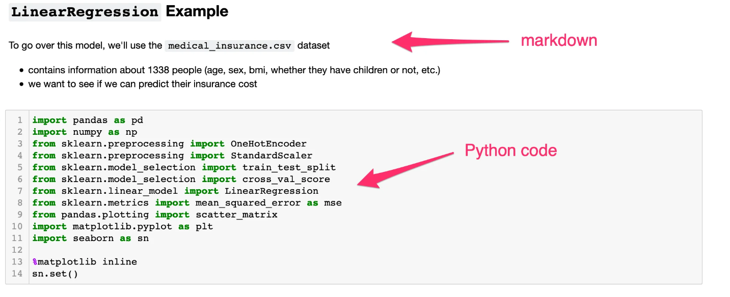
Code reproducibility and research
Jupyter notebooks are dynamic documents
Markdown cells
Write code (which can be reused as template)

Slide 42
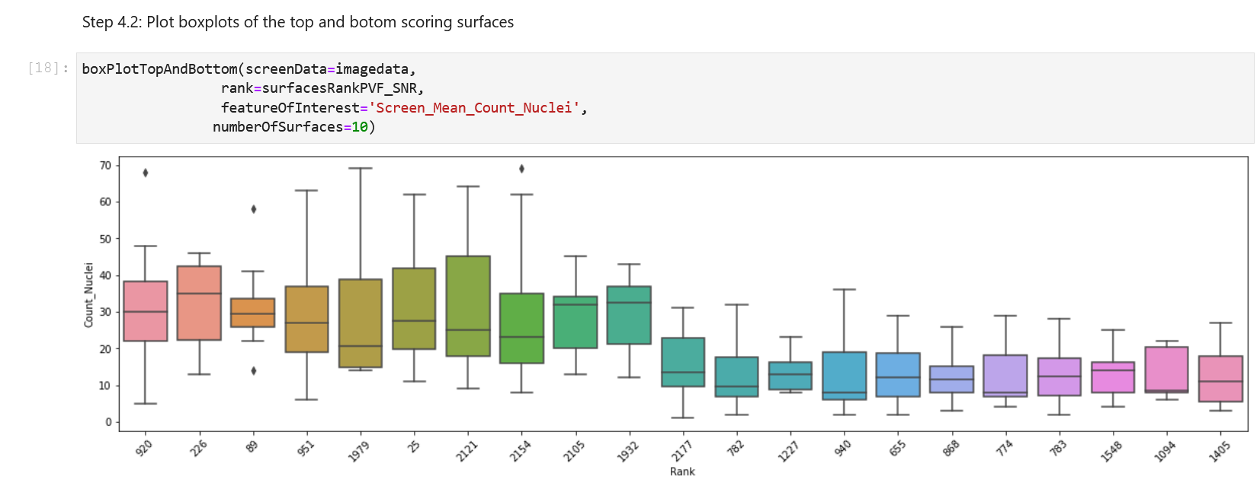
Code reproducibility and research
Share your results and document your analysis

Slide 43


Code reproducibility and research
Add data to software package
+

Slide 44
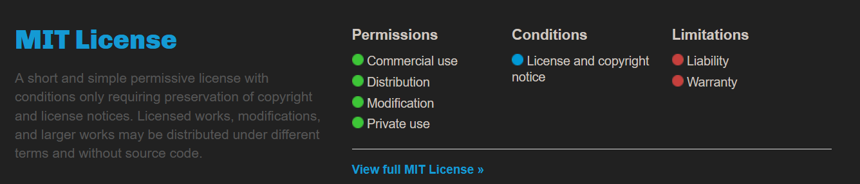
Code reproducibility and research
Choosing an open-source licence
Share licensed software:
Permission to reuse code
Conditions when someone uses your code
https://choosealicense.com/licenses/

Slide 45
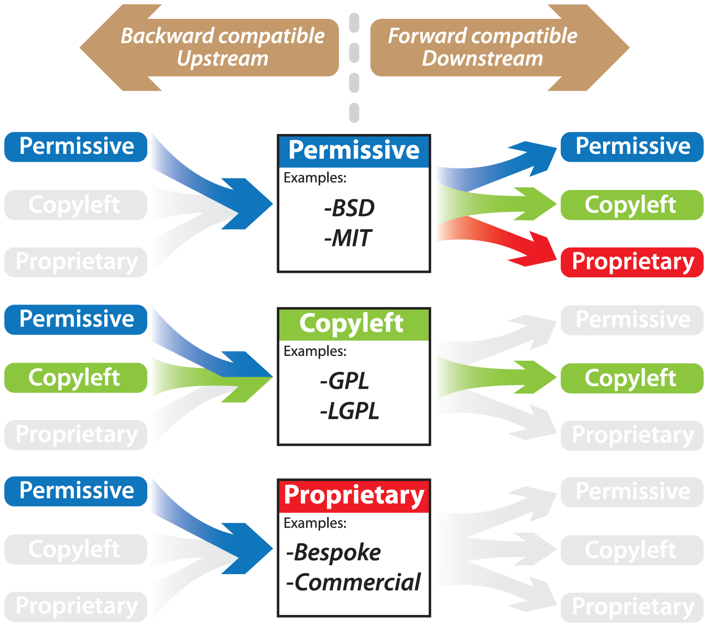
Code reproducibility and research
Morin et al. (2012). 10.1371/journal.pcbi.1002598

Slide 46
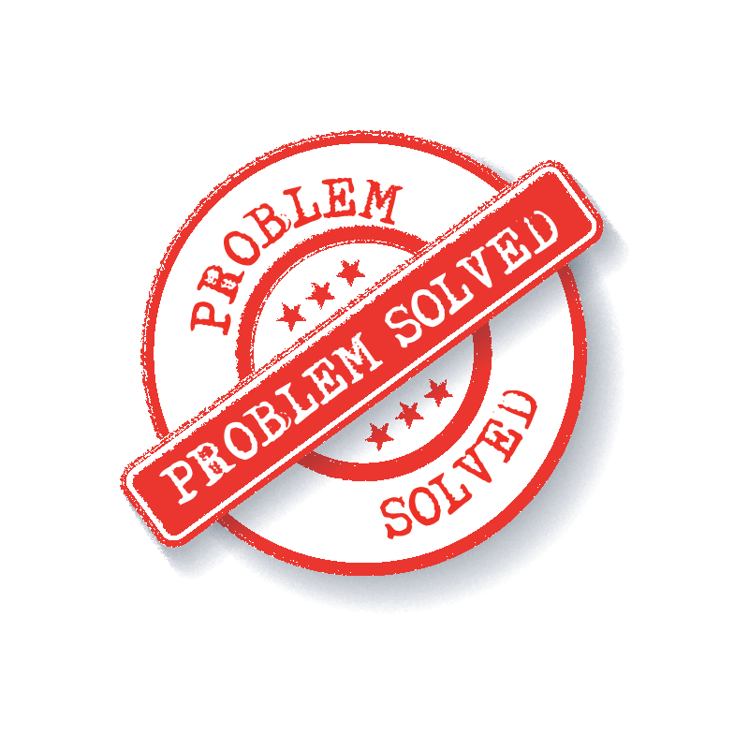

Code reproducibility and research
?

Slide 47
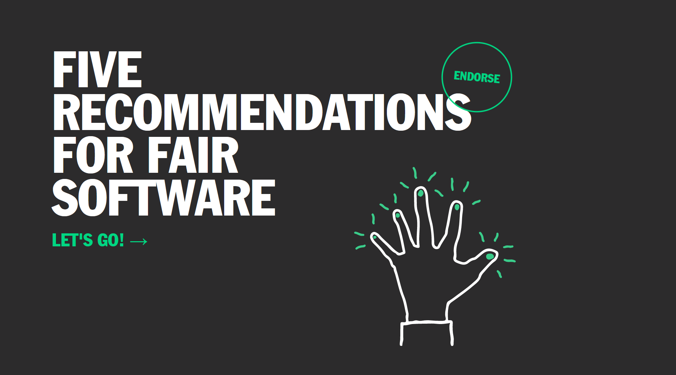
Code reproducibility and research
https://fair-software.eu/

